Slide 1

Echipa

Slide 2

Team Players
Csongor Barát
Team Leader
Raluca Ioniță
QA Engineer
Robert Iordănoaia
QA Engineer
George Luncasu
QA Engineer
Mihai Miron
QA Engineer
Vlad Manea
QA Engineer
Cristina Teodorescu
Scrum Master
Roxana Ojog
Mentor
Oana Matasel
Head of Study

Slide 3
Trello
We used this ticketing platform to track the progress of the team, for ease of access to the base materials and for the entire team to be able to see at first hand the activities and the deadlines. The requirements an the tasks were divided in multiple cards, to organize an keep track of each stage and quickly see the deadlines
https://trello.com/b/GD1YjqjQ/cashify-project
Jira
We chose this tool to input the test cases and bug reports, in order to practice using the platform in preparation for a real environment. After creating the tests checklist (mentioned in Trello), we divided it by sections and the team shared responsibilities in creating test cases based by the section assigned to each of the team member.
The team also ran the test cases and then opened bug reports in Jira as well.
https://proiectgoitechipa2.atlassian.net/jira/software/c/projects/CASH/boards/2
Excel

Slide 4
Test Methodology
The selected test methodology for the testing process was agile, because agile supports continuous testing workflows and a reactive approach, exploratory testing which is necessary to finish the testing process in a short time.
At the integration test level testers use the Top-Down approach.

Slide 5
Techniques we used:
Static testing
Reviews
Peer review
Test levels
Integration Testing - Login functionality- user account, income-balance, expenses-balance
Confirmation Testing - Retesting features after Debugging.
Regression Testing
System Testing - End-to-end test, Use cases, User stories

Slide 6
Black box testing techniques
Equivalence partitioning
Boundary value analysis
Pairwise testing
Non-functional
Usability testing
Security testing
Compatibility testing

Slide 7
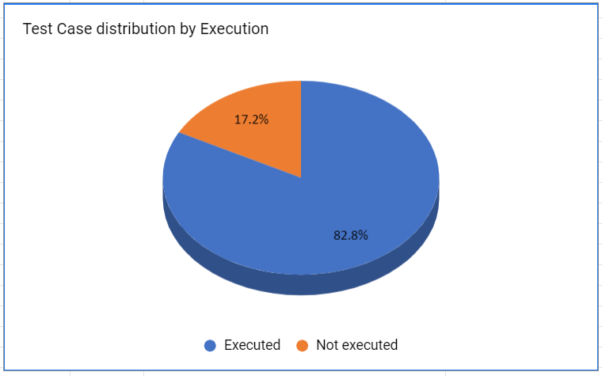
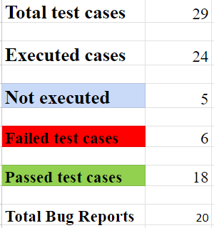
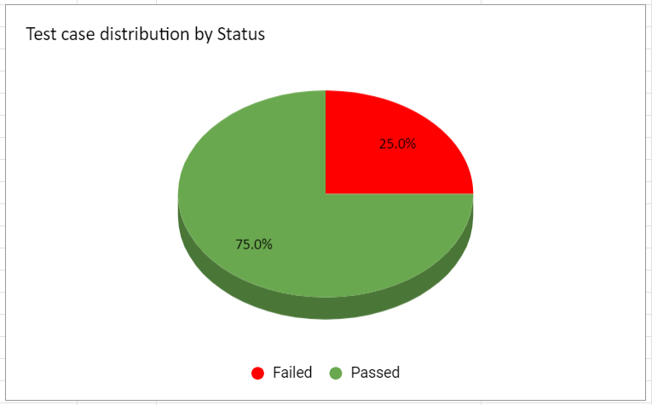

Slide 8
One of the most critical errors:
Login protocol - insecure protocol, data vulnerability, login at this point can be processed with any email address, real or not real, not verified and data that is not yours can easily be used by someone else
Terms of Service missing - not legally compliant

Slide 9
Thank you!

